Slide 1
LINUX AND SHELL SCRIPTING

Slide 2
Learning Outcomes
understand the file descriptors, parameters and variables, builtins and expressions

Slide 3
File Descriptor
Before a process can read from or write to a file, it must open that file.
When a process opens a file, Linux associates a number (called a file descriptor) with the file.
A file descriptor is an index into the process’s table of open files.

Slide 4
File Descriptor
Each process has its own set of open files and its own file descriptors.
After opening a file, a process reads from and writes to that file by referring to its file descriptor.
When it no longer needs the file, the process closes the file, freeing the file descriptor.

Slide 5
File Descriptor
A typical Linux process starts with three open files: standard input (file descriptor 0), standard output (file descriptor 1), and standard error (file descriptor 2).
Often these are the only files the process needs.

Slide 6
Opening a File Descriptor
The Bourne Again Shell opens files using the exec builtin as follows:
  exec n> outfile
  exec m< infile
The first line opens out file for output and holds it open, associating it with file descriptor n.
The second line opens in file for input and holds it open, associating it with file descriptor m.

Slide 7
Duplicating a File Descriptor
<& token duplicates an input file descriptor.
>& duplicates an output file descriptor.
You can duplicate a file descriptor by making it refer to the same file as another open file descriptor, such as standard input or output.

Slide 8
Duplicating a File Descriptor
To open or redirect file descriptor n as a duplicate of file descriptor
m: exec n<&m

Slide 9
Duplicating a File Descriptor
Once you have opened a file, you can use it for input and output in two ways.
First, you can use I/O redirection on any command line, redirecting standard output to a file descriptor with >&n or redirecting standard input from a file descriptor with <&n.
Second, you can use the read and echo builtins. If you invoke other commands, including functions, they inherit these open files and file descriptors.

Slide 10
Duplicating a File Descriptor
When you have finished using a file, you can close it using:
exec n<&–

Slide 11
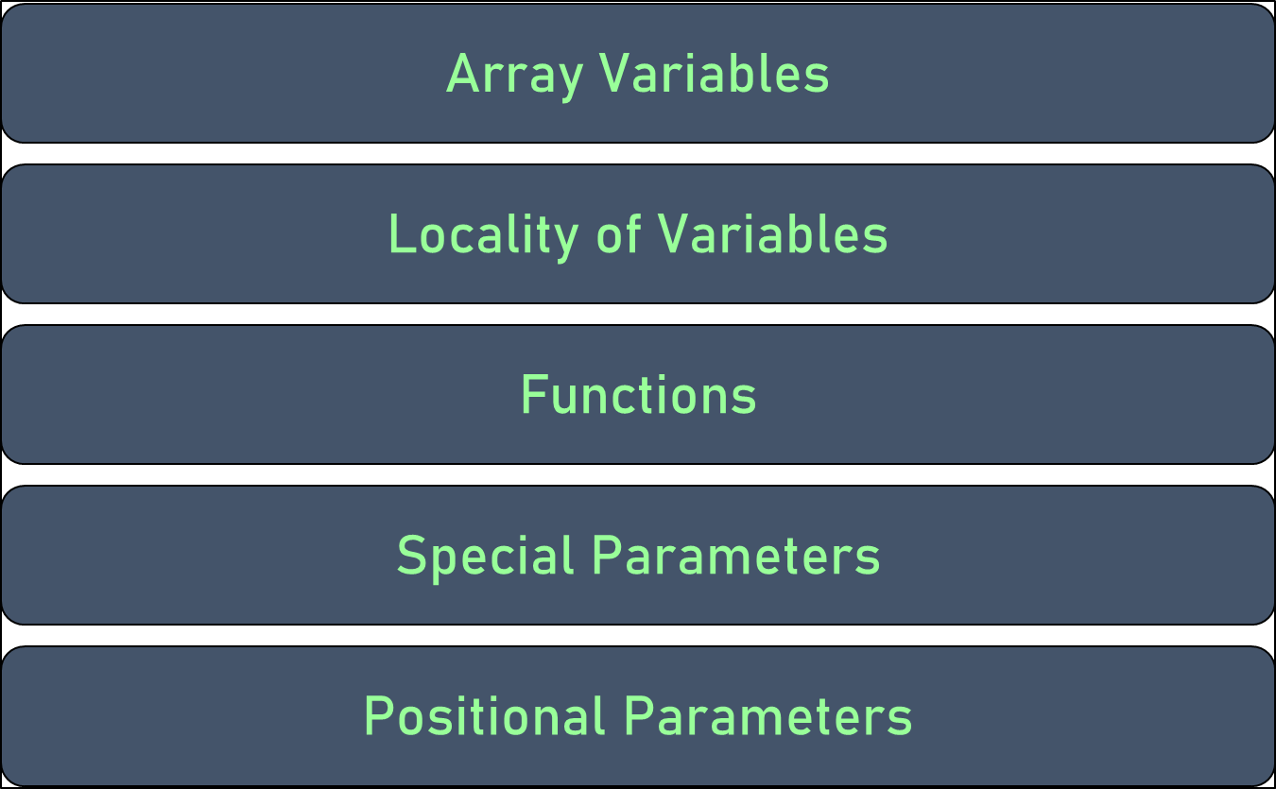
Parameters and Variables

Slide 12
Array Variables
The Bourne Again Shell supports one-dimensional array variables.
The subscripts are integers with zero-based indexing (i.e., the first element of the array has the subscript 0).

Slide 13
Array Variables
Declaration and assignment of values to an array:
name=(element1 element2 ...)
Assigns four values to the array NAMES:
$ NAMES=(max helen sam zach)
Reference a single element of an array as follows:
$ echo ${NAMES[2]}
sam

Slide 14
Locality of Variables
By default variables are local to the process in which they are declared.
Thus a shell script does not have access to variables declared in your login shell unless you explicitly make the variables available (global).
Under bash, export makes a variable available to child processes. Under tcsh, setenv assigns a value to a variable and makes it available to child processes.

Slide 15
Locality of Variables (Without Export)
$ cat extest1
cheese = american
echo "extest1 1: $cheese"
subtest
echo "extest1 2: $cheese"

Slide 16
Locality of Variables (Without Export)
$ cat subtest
echo "subtest 1: $cheese"
cheese=swiss
echo "subtest 2: $cheese"

Slide 17
Locality of Variables (Without Export)
$ ./extest1
extest1 1: american
subtest 1:
subtest 2: swiss
extest1 2: american

Slide 18
Locality of Variables (With export)
$ cat extest2
export cheese=american
echo "extest2 1: $cheese"
subtest
echo "extest2 2: $cheese"

Slide 19
Locality of Variables (With export)
$ ./extest2
extest2 1: american
subtest 1: american
subtest 2: swiss
extest2 2: american

Slide 20
Locality of Variables
An export builtin can optionally include an assignment:
export cheese = american
The preceding statement is equivalent to the following two statements:
cheese = american
export cheese

Slide 21
Functions
Because functions run in the same environment as the shell that calls them, variables are implicitly shared by a shell and a function it calls.

Slide 22
Functions
The myname variable is set to sam in the interactive shell.
The nam function then displays the value of myname (sam) and sets myname to zach.
The final echo shows that, in the interactive shell, the value of myname has been changed to zach.
$ function nam () {
> echo $myname
> myname=zach
> }
$ myname=sam
$ nam
sam
$ echo $myname
zach

Slide 23
Special Parameters
Special parameters enable you to access useful values pertaining to command-line arguments and the execution of shell commands.
You reference a shell special parameter by preceding a special character with a dollar sign ($).

Slide 24
Special Parameters
$$: PID Number
The shell stores in the $$ parameter the PID number of the process that is executing it.

Slide 25
Special Parameters
In this example, echo displays the value of this variable and the ps utility confirms its value. Both commands show that the shell has a PID number of 5209:
$ echo $$
  5209
  $ ps
  PID TTY TIME CMD
  5209 pts/1 00:00:00 bash
  6015 pts/1 00:00:00 ps

Slide 26
Special Parameters
$?: Exit Status
When a process stops executing for any reason, it returns an exit status to its parent process.
The exit status is also referred to as a condition code or a return code.
The $? ($status under tcsh) variable stores the exit status of the last command.

Slide 27
Special Parameters
By convention a nonzero exit status represents a false value and means the command failed. A zero is true and indicates the command executed successfully.

Slide 28
Special Parameters
The first ls command succeeds and the second fails, as demonstrated by the exit status:
$ ls es
es
$ echo $?
0
$ ls xxx
ls: xxx: No such file or directory
$ echo $?
1

Slide 29
Positional Parameters
Positional parameters comprise the command name and command-line arguments.
These parameters are called positional because within a shell script, you refer to them by their position on the command line.
Only the set builtin allows you to change the values of positional parameters. However, you cannot change the value of the command name from within a script.
The tcsh set builtin does not change the values of positional parameters.

Slide 30
Positional Parameters
$#: Number of Command-Line Arguments
The $# parameter holds the number of arguments on the command line (positional parameters), not counting the command itself:
$ cat num_args
echo "This script was called with $# arguments."
$ ./num_args sam max zach
This script was called with 3 arguments.

Slide 31
Positional Parameters
$0: Name of the Calling Program
The shell stores the name of the command you used to call a program in parameter $0. This parameter is numbered zero because it appears before the first argument on the command line:
$ cat abc
echo "The command used to run this script is $0"
$ ./abc
The command used to run this script is ./abc
$ ~sam/abc
The command used to run this script is /home/sam/abc

Slide 32
Positional Parameters
$1–$n: Command-Line Arguments
The first argument on the command line is represented by parameter $1, the second argument by $2, and so on up to $n. For values of n greater than 9, the number must be enclosed within braces. For example, the twelfth command-line argument is represented by ${12}. The following script displays positional parameters that hold command-line arguments:
$ cat display_5args
echo First 5 arguments are $1 $2 $3 $4 $5
$ ./display_5args zach max helen
First 5 arguments are zach max helen

Slide 33
Positional Parameters
shift: Promotes Command-Line Arguments
The shift builtin promotes each command-line argument.
The first argument (which was $1) is discarded.
The second argument (which was $2) becomes the first argument (now $1), the third becomes the second, and so on.

Slide 34
Positional Parameters
Because no “unshift” command exists, you cannot bring back arguments that have been discarded.
An optional argument to shift specifies the number of positions to shift (and the number of arguments to discard); the default is 1.

Slide 35
Positional Parameters
$ cat demo_shift
echo "arg1= $1 arg2= $2 arg3= $3"
shift
echo "arg1= $1 arg2= $2 arg3= $3"
shift
echo "arg1= $1 arg2= $2 arg3= $3"
shift
echo "arg1= $1 arg2= $2 arg3= $3"
shift

Slide 36
Positional Parameters
$ ./demo_shift alice helen zach
arg1= alice arg2= helen arg3= zach
arg1= helen arg2= zach arg3=
arg1= zach arg2= arg3=
arg1= arg2= arg3=

Slide 37
Positional Parameters
set: Initializes Command-Line Arguments
When you call the set builtin with one or more arguments, it assigns the values of the arguments to the positional parameters, starting with $1 (not available in tcsh).

Slide 38
Positional Parameters
The following script uses set to assign values to the positional parameters $1, $2, and $3:
$ cat set_it
set this is it
echo $3 $2 $1
$ ./set_it
it is this

Slide 39
Positional Parameters
$* and $@: Represent All Command-Line Arguments
The $* parameter represents all command-line arguments, as the display_all program demonstrates:
$ cat display_all
echo All arguments are $*
$ ./display_all a b c d e f g h i j k l m n o p
All arguments are a b c d e f g h i j k l m n o p

Slide 40
Builtin Commands
Builtins | Funcexittions
: | Returns 0 or true
. | Executes a shell script as part of the current process
bg | Puts a suspended job in the background
break | Exits from a looping control structure
cd | Changes to another working directory
continue | Starts with the next iteration of a looping control structure
echo | Displays its arguments
eval | Scans and evaluates the command line
exec | Executes a shell script or program in place of the current process
export | Exits from the current shell

Slide 41
Builtin Commands
fg | Brings a job from the background into the foreground
getopts | Parses arguments to a shell script
jobs | Displays a list of background jobs
kill | Sends a signal to a process or job
pwd | Displays the name of the working directory
read | Reads a line from standard input
readonly | Declares a variable to be readonly
set | Sets shell flags or command-line argument variables; with no argument, lists all variables
shift | Promotes each command-line argument
test | Compares arguments
times | Displays total times for the current shell and its children

Slide 42
Builtin Commands
trap | Traps a signal
type | Displays how each argument would be interpreted as a command
umask | Returns the value of the file-creation mask
unset | Removes a variable or function
wait | Waits for a background process to terminate

Slide 43
Expressions
An expression comprises constants, variables, and operators that the shell can process to return a value.

Slide 44
Arithmetic Evaluation
The Bourne Again Shell can perform arithmetic assignments and evaluate many different types of arithmetic expressions, all using integers.
The shell performs arithmetic assignments in a number of ways.
One is with arguments to the let builtin:
$ let "VALUE=VALUE * 10 + NEW"

Slide 45
Arithmetic Evaluation
Within a let statement you do not need to use dollar signs ($) in front of variable names.
Double quotation marks must enclose a single argument, or expression, that contains SPACEs.
Because most expressions contain SPACEs and need to be quoted, bash accepts ((expression)) as a synonym for let "expression", obviating the need for both quotation marks and dollar signs:
$ ((VALUE=VALUE * 10 + NEW))

Slide 46
Logical Expressions
$ cat age2
#!/bin/bash
echo -n "How old are you? "
read age
if ((30 < age && age < 60)); then
echo "Wow, in $((60-age)) years, you'll be 60!"
else
echo "You are too young or too old to play."
fi
$ ./age2
How old are you? 25
You are too young or too old to play.

Slide 47
Logical Evaluation (Conditional Expressions)
The syntax of a conditional expression is
[[ expression ]]
where expression is a Boolean (logical) expression. You must precede a variable name with a dollar sign ($) within expression.
The result of executing this builtin, as with the test builtin, is a return status.

Slide 48
Logical Evaluation (Conditional Expressions)
The conditions allowed within the brackets are almost a superset of those accepted by test.
Where the test builtin uses –a as a Boolean AND operator, [[ expression ]] uses &&.
Similarly, where test uses –o as a Boolean OR operator, [[ expression ]] uses ||.

Slide 49
String Comparisons
The test builtin tests whether strings are equal.
The [[ expression ]] syntax adds comparison tests for string operators.
The > and < operators compare strings for order (for example, "aa" < "bbb").

Slide 50
String Comparisons
The = operator tests for pattern match, not just equality: [[ string = pattern ]] is true if string matches pattern. This operator is not symmetrical; the pattern must appear on the right side of the equal sign.
For example,
[[ artist = a* ]] is true (= 0), whereas [[ a* = artist ]] is false (= 1):
$ [[ artist = a* ]]
$ echo $?
0
$ [[ a* = artist ]]
$ echo $?
1

Slide 51
String Pattern Matching
The Bourne Again Shell provides string pattern-matching operators that can manipulate pathnames and other strings. These operators can delete from strings prefixes or suffixes that match patterns.

Slide 52
String Pattern Matching
Operator | Function
# | Removes minimal matching prefixes
## | Removes maximal matching prefixes
% | Removes minimal matching suffixes
%% | Removes maximal matching suffixes

Slide 53
String Pattern Matching
The syntax for these operators is
${varname op pattern}
where op is one of the operators and pattern is a match pattern similar to that used for filename generation.

Slide 54
Operators
Arithmetic expansion and arithmetic evaluation in bash use the same syntax, precedence, and associativity of expressions as in the C language.
Within an expression you can use parentheses to change the order of evaluation.

Slide 55
Operators
Type of Operator | Function
Post
 | Var++ Postincrement Var-- Postdecrement
Pre
 | ++var Preincrement --var Predecrement
Unary
 | + Unary Plus - Unary Minus
Negation
 | ! Boolean NOT ~ Complement

Slide 56
Operators
Exponentiation
 | ** Exponent
Multiplication, Division, Remainder
 | * Multiplication
 | / Division
 | % Remainder
Addition, Subtraction
 | + Addition
 | - Subtraction
Bitwise Shifts
 | << Left bitwise shift
 | >> Right bitwise shift

Slide 57
Operators
Comparison
 | <= Less than or equal to
 | >= Greater than or equal to
 | < less than
 | > Greater than
Equality, inequality
 | == Equality
 | != Inequality
Bitwise
 | * Bitwise AND
 | ^ Bitwise XOR
 | | Bitwise OR

Slide 58
Operators
Boolean (Logical)
 | && Boolean AND
 | || Boolean OR
Conditional Evaluation
 | ?: Ternary Operator
Assignment
 | =, *=, /=, %=, +=, -=, <<=, >>=, &=, ^=, |= Assignment
Comma
 | , Comma

Slide 59
Operators
The pipe token has higher precedence than operators. You can use pipes anywhere in a command that you can use simple commands. For example, the command line
$ cmd1 | cmd2 || cmd3 | cmd4 && cmd5 | cmd6
is interpreted as if you had typed
$ ((cmd1 | cmd2) || (cmd3 | cmd4)) && (cmd5 | cmd6)

